Slide 1
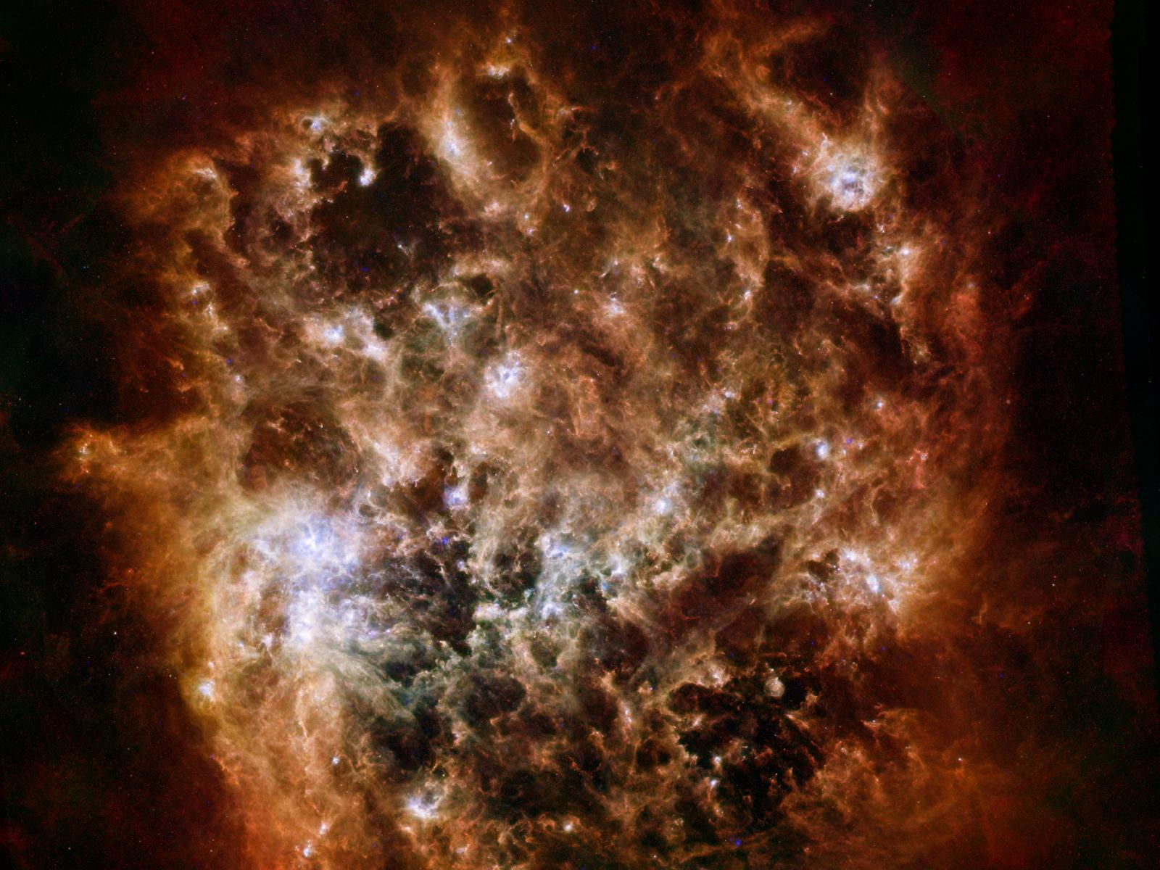

Space-VLBI Multi-frequency Capabilities
A. G. Rudnitskiy, S. F. Likhachev, V. I. Kostenko
A. S. Andrianov, I. A. Girin
Astro Space Center of Lebedev Physical Institute
Data Processing Department
Multi-frequency Mm-wave Radio Telescopes & Other Software Controlled Operations
October 5 – 7, 2015, Florence, Italy
Large Magellanic Cloud as Seen by Herschel and Spitzer
Credit: ESA/NASA/JPL-Caltech/STScI

Slide 2

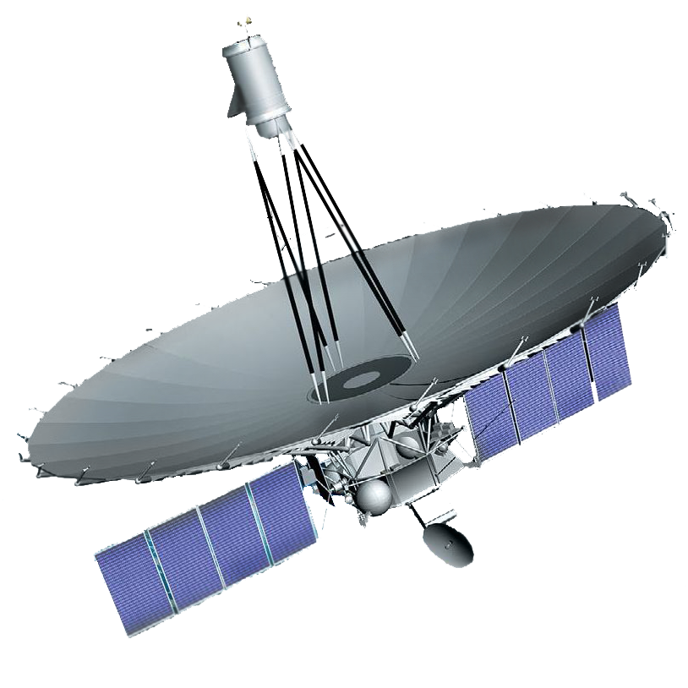
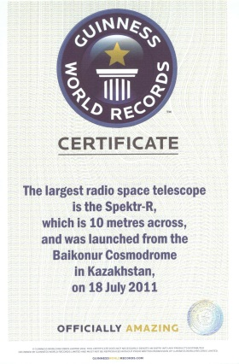
Radioastron Mission
The largest in the world 10-m deployable space radio telescope.
Launched on 18th of July, 2011
- Daily Space-VLBI observations
- Support from more than 30 ground radio telescopes around the world
- Orbit around the Earth up to 300 000 km
- More than 4 years of successful operation
- Multi-frequency observations capability (18392 – 25112 MHz)
Studies on:
- AGN+QSO (imaging, surveys)
- Masers (imaging, surveys)
- Pulsars (ISM, scattering effects, etc.)
Frequency bands:
316 MHz, 1660 MHz, 4868 MHz, 22220 MHz

Slide 3
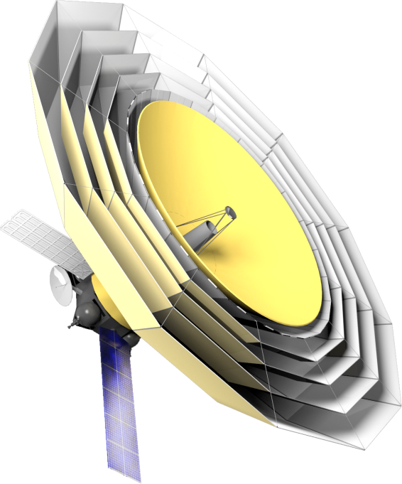
Millimetron Mission
The first 10-m deployable and cooled space
sub-mm and FIR telescope.
Mission has been approved and supported by Russian Space Agency
- FIR, sub-mm and mm range
- In orbit deployable and adjustable antenna
- Cosmology and astrophysics studies
- Mechanically cooled (<10K) with post-cryo life
- Orbit around L2 Lagrange point
- Lifetime: 10 years; at cryo >3 years
Dual operation modes:
S-VLBI for: 1 – 17 mm
Single dish for: 0.06 – 3 mm
Spacecraft in Phase-B
Science payload in Phase-A
Launch date : 2020++

Slide 4
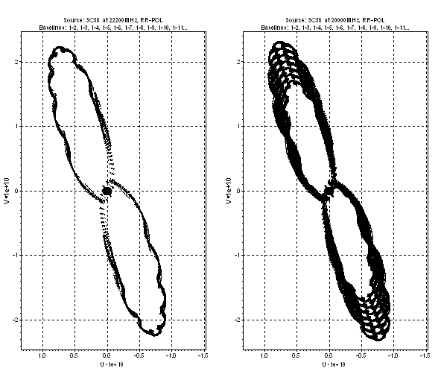
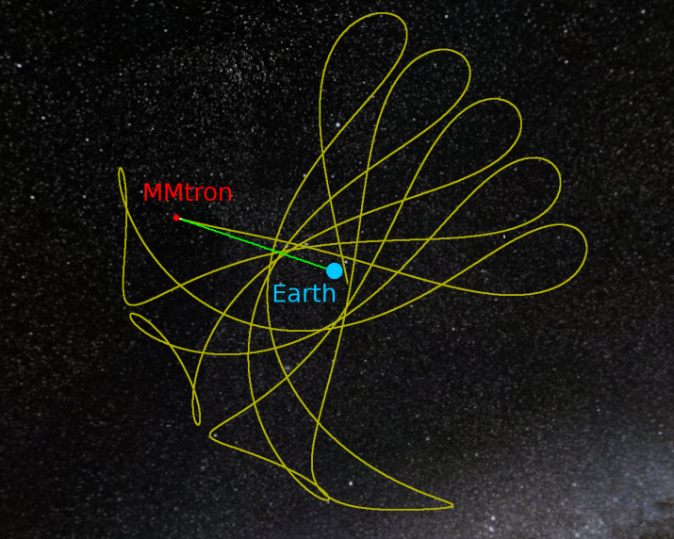
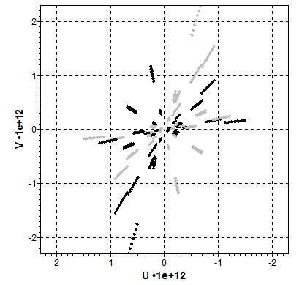
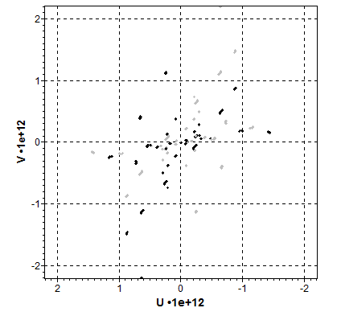
(u, v) - coverage examples
Radioastron - VLBA
Millimetron - EHT (snap-shot)

Slide 5
What is Multi-frequency Imaging?
The main idea of Multi-frequency imaging (MFI) is to obtain detailed information about a radio source (intensity distribution) and its spectral parameters (e.g. spectral index) using the observations in a wide frequency range.
In 1998 a task was stated at ASC LPI to develop a receiver in frequency range from 18 to 25 GHz for “Radioastron” project in order to improve
the (u, v)-coverage at least up to 30%.

Slide 6
Multi-frequency Imaging
Multi-frequency imaging (MFI) consists of:
Multi-frequency synthesis (MFS): image synthesis and deconvolution procedures (CLEAN, etc.)
Multi-frequency analysis (MFA): estimation of the image parameters (spectral indexes, etc.)

Slide 7
Advantages
MFI provides enhanced angular resolution and quality for any image due to improved (u, v)-coverage and, hence, better parameters of the dirty beam!
Improvement of (u, v)-coverage and increasing of dynamic range of the deconvolved image of the radio source.
Map synthesis for spectral index and its frequency dependence (including possibility of polarization parameter estimation as well as Faraday rotation measure and polarization imaging)
Differential astrometry and interstellar diffraction

Slide 8
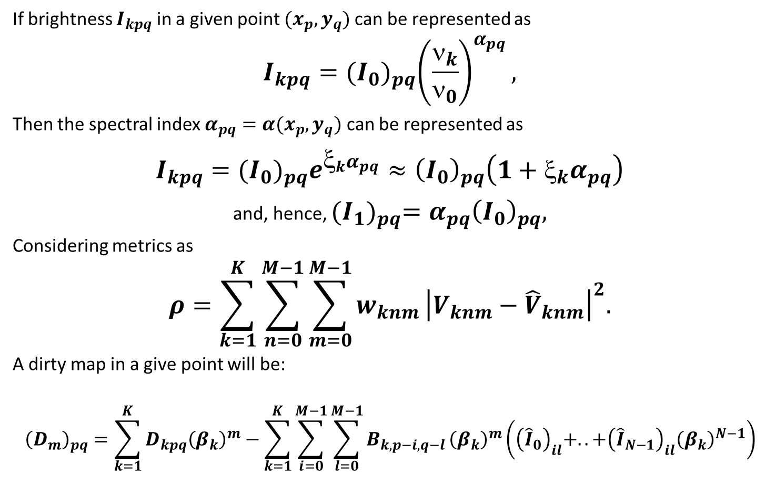
Multi-frequency Imaging Formalism
If brightness $I_{kpq}$ in a given point $(x_{p}, y_{q})$can be represented as
$$I_{kpq}={(I_{0})}_{pq}{\left(\frac{ν_{k}}{ν_{0}}\right)}^{α_{pq}},$$
Then the spectral index $α_{pq}=α(x_{p}, y_{q})$ can be represented as
$I_{kpq}={(I_{0})}_{pq}e^{ξ_{k}α_{pq}}≈{\left(I_{0}\right)}_{pq}\left(1+ξ_{k}α_{pq}\right)$
and, hence, ${(I_{1})}_{pq}={α_{pq}\left(I_{0}\right)}_{pq},$
Considering metrics as
$$ρ=\sum_{k=1}^{K}{\sum_{n=0}^{M−1}{\sum_{m=0}^{M−1}{w_{knm}}}}{\left|V_{knm}−{\hat{V}}_{knm}\right|}^{2}.$$
A dirty map in a give point will be:
$${\left(D_{m}\right)}_{pq}=\sum_{k=1}^{K}{D_{kpq}{\left(β_{k}\right)}^{m}−\sum_{k=1}^{K}{\sum_{i=0}^{M−1}{\sum_{l=0}^{M−1}{B_{k, p−i,q−l}}}}}{\left(β_{k}\right)}^{m}\left({\left({\hat{I}}_{0}\right)}_{il}+..+{\left({\hat{I}}_{N−1}\right)}_{il}{\left(β_{k}\right)}^{N−1}\right)$$

Slide 9
Comparison with Other Algorithms
Comparing to previously developed MFS algorithms (Sault, Conway, et. al.), current MFI approach is capable of:
Estimation of spectral index and image at reference frequency is performed together at several frequencies from directly measured visibility function on an united (u, v)-plane (instead of separate analysis of maps synthesized at each frequency separately with poor (u, v)-coverage)
Usage of N-order vector relaxation method (N – number of frequency channels) instead of empiric Double Deconvolution scheme (double usage of scalar CLEAN procedure)

Slide 10
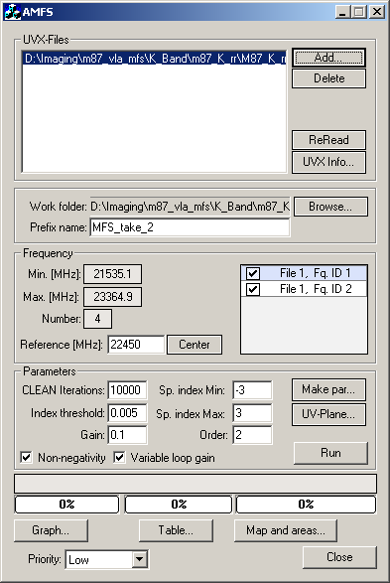
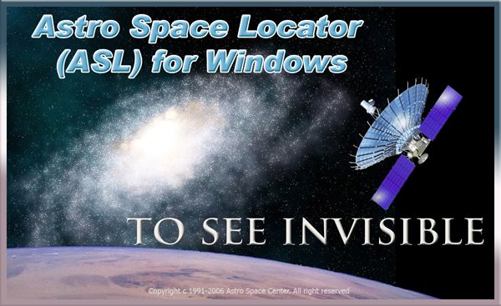
Astro Space Locator Software
Software package developed at Astro Space Center.
- Operates under Microsoft Windows and Linux.
- Provides all necessary instrumentations for VLBI data
post-correlation editing, analysis and imaging.
- Includes the improved MFS and MFA algorithms.
ASL Software package MFS
and MFA algorithms provide
an ability to estimate spectral
index map for any
intermediate frequency
in a given observational range.

Slide 11
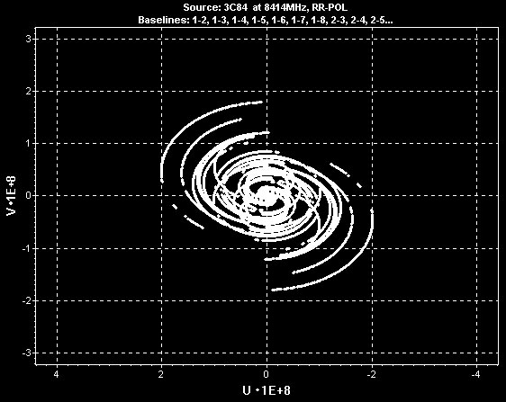
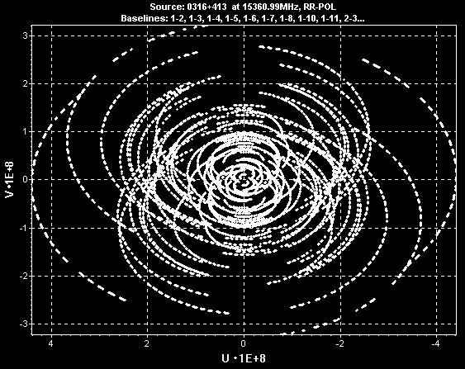
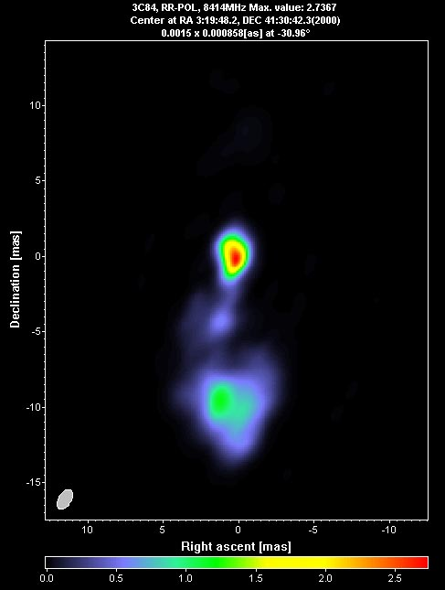
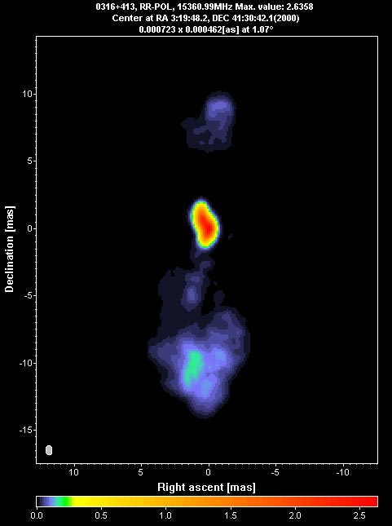
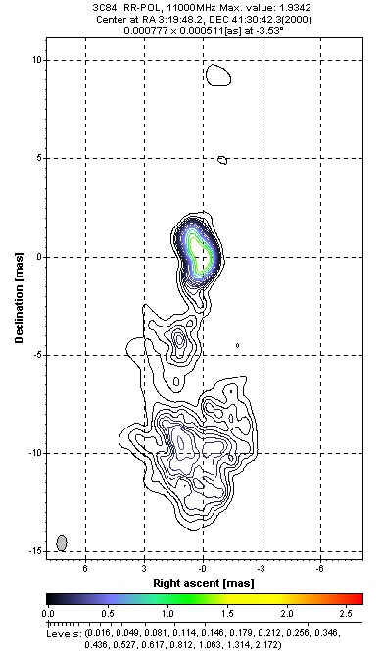
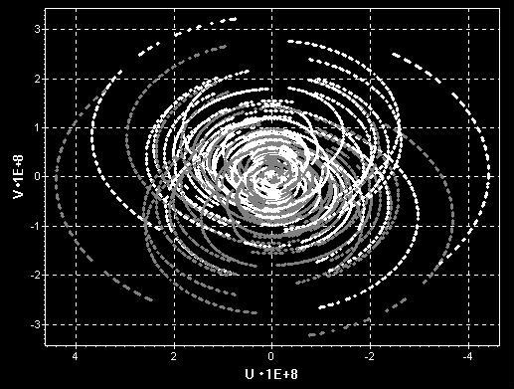
Multi-Frequency Imaging
(3C84)
8GHz
15GHz
Observations done with VLBA.

Slide 12
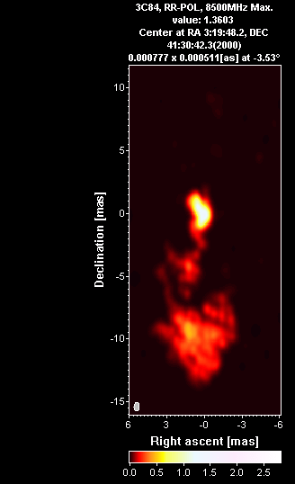
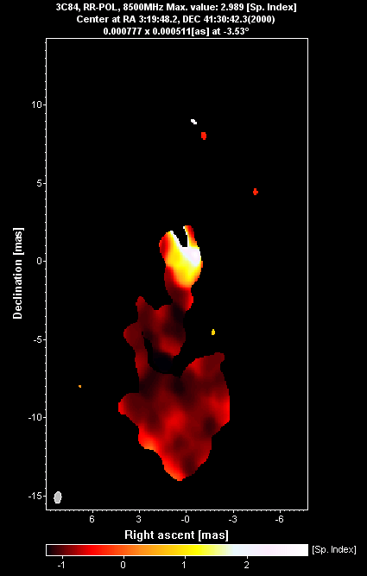
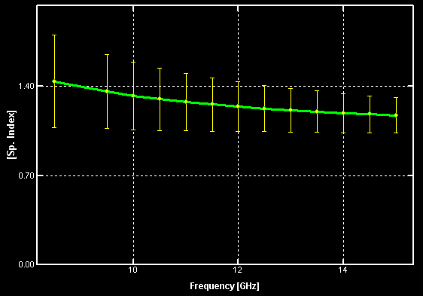
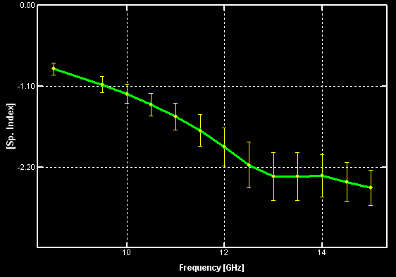
Multi-Frequency Imaging
(3C84)
Core spectra:
Jet spectra:
Observations done with VLBA.

Slide 13
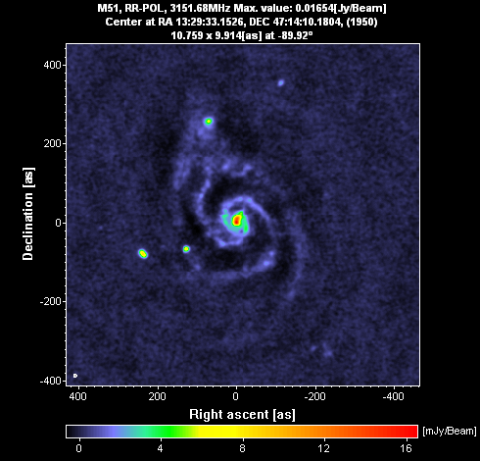
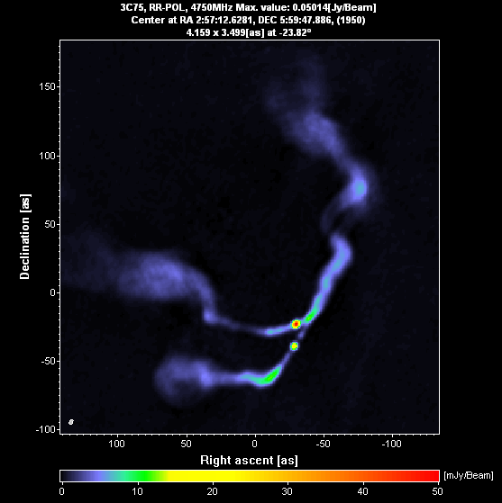
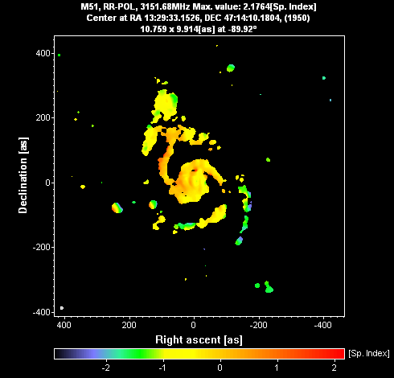
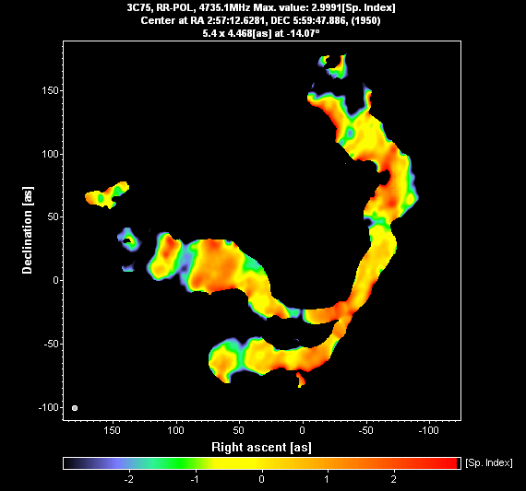
Multi-Frequency Imaging
(M51, 3C75)
Observations done with VLA.

Slide 14
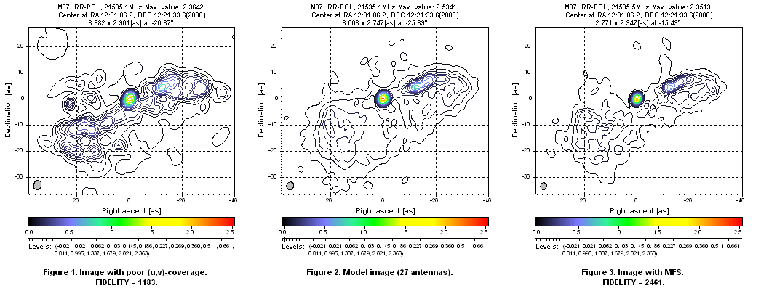
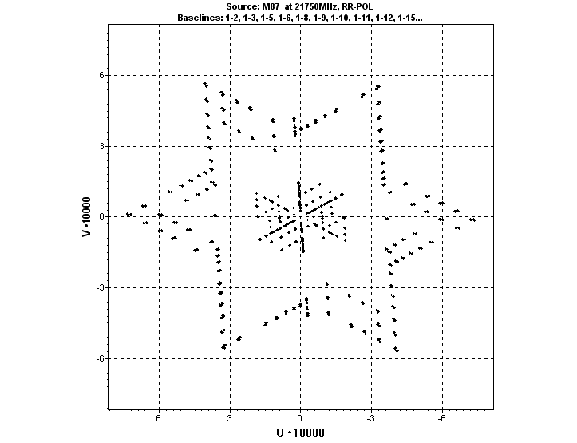
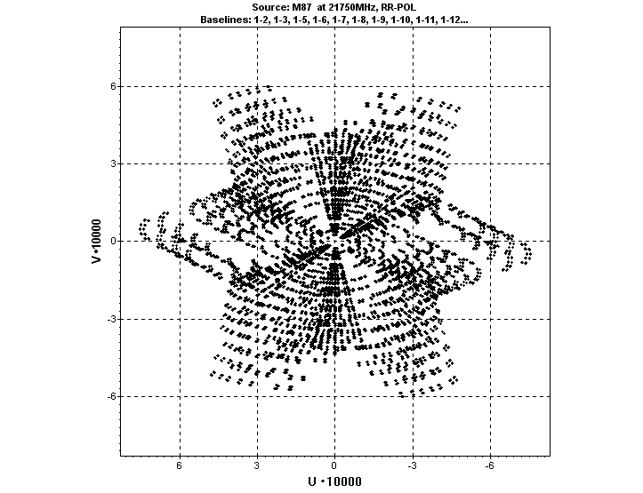
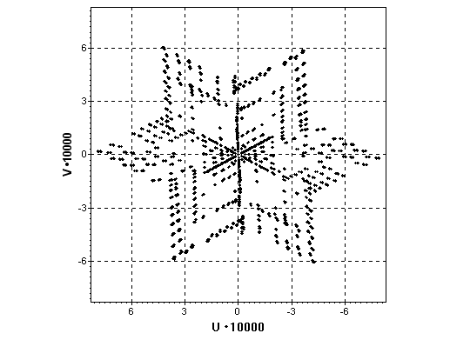
Multi-frequency Imaging
(M87)
Observations done with VLA.

Slide 15
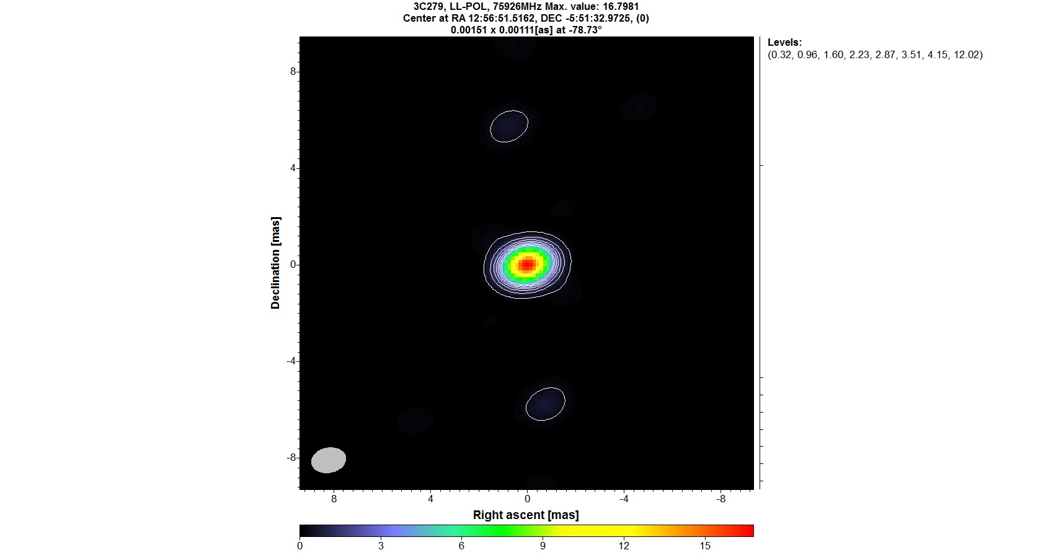
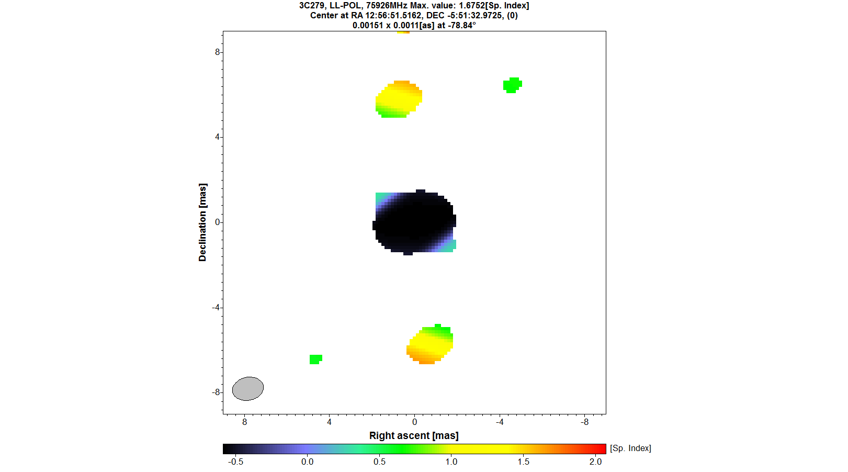
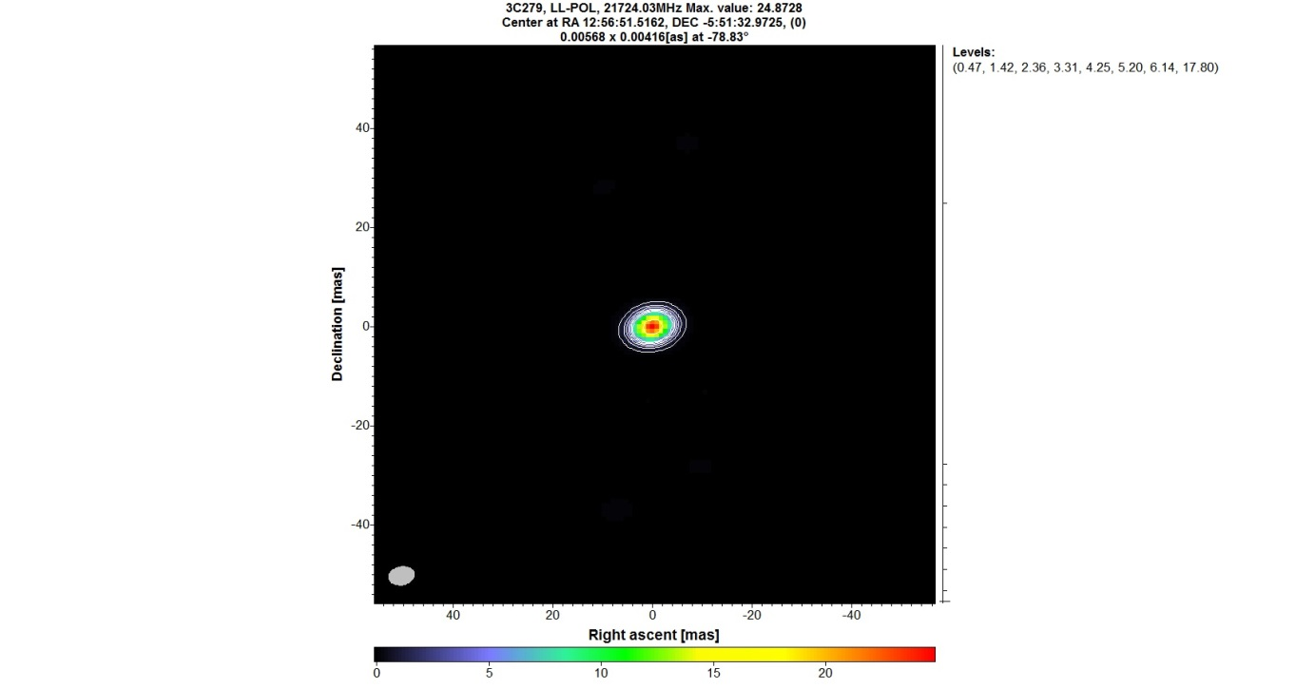
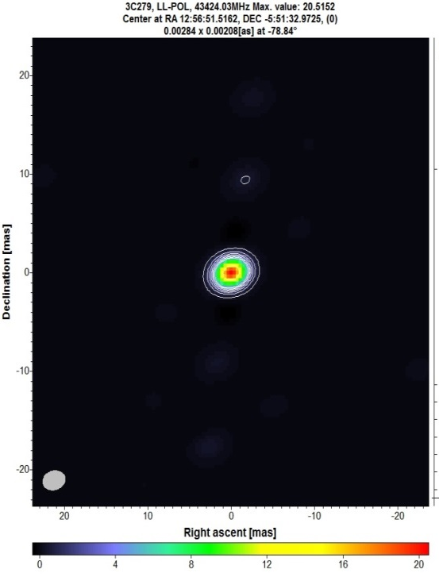
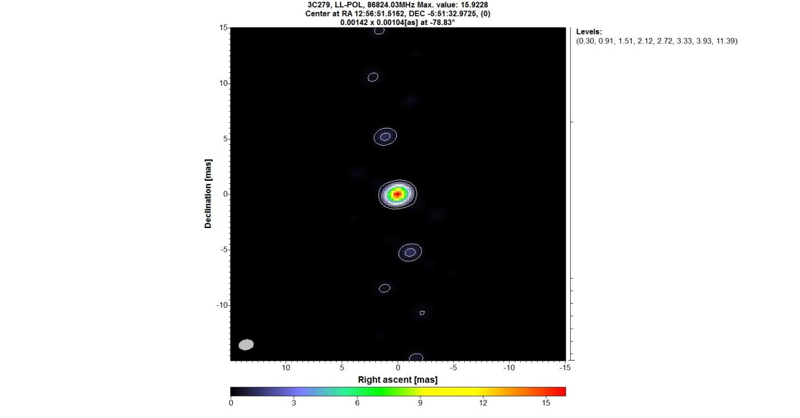
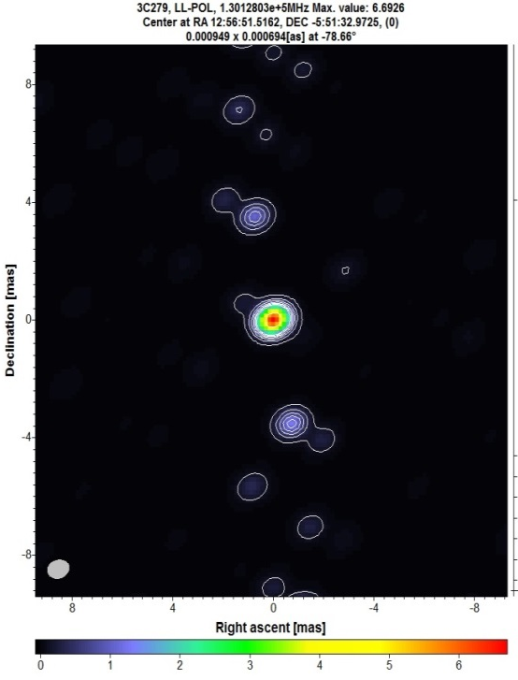
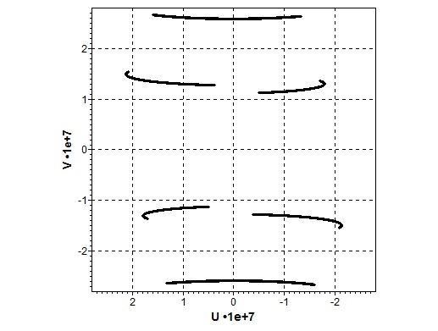

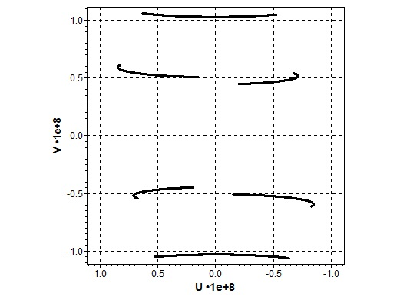
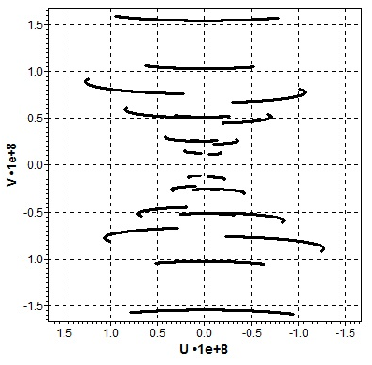
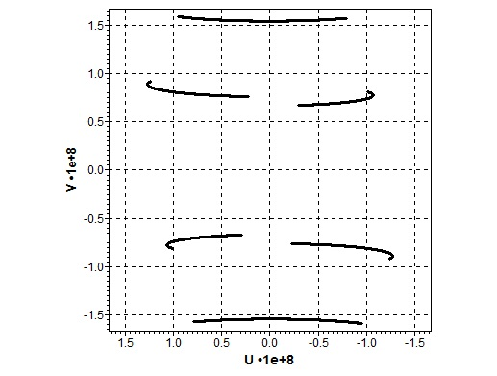
Multi-Frequency Imaging
(3C279)
22GHz
43GHz
86GHz
129GHz
Observations done with KVN (Korean VLBI Network). Courtesy of Taehyun Jung.

Slide 16
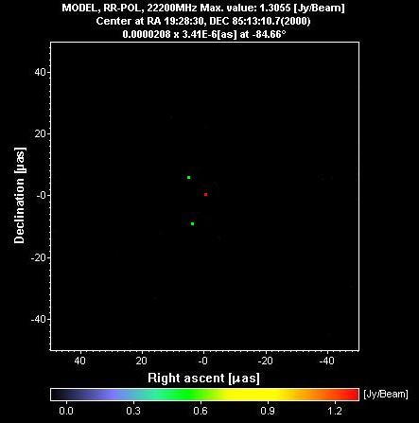
MFS with Radioastron
Radioastron-VLBA
Model - three delta functions:
Flux [Jy] Distance [as]
Delta func. 1 1 0
Delta func. 2 0.5 9⋅10⁻⁶
Delta func. 3 0.5 1.2⋅10⁻⁵
Simulations were done for Radioastron - VLBA

Slide 17
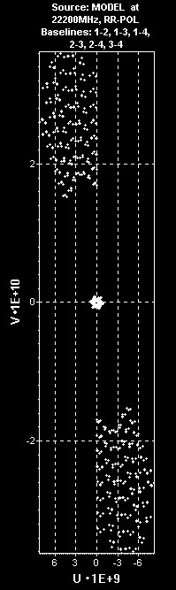
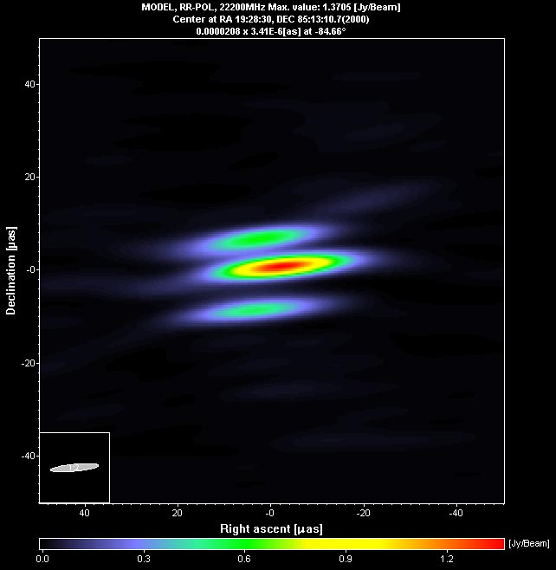
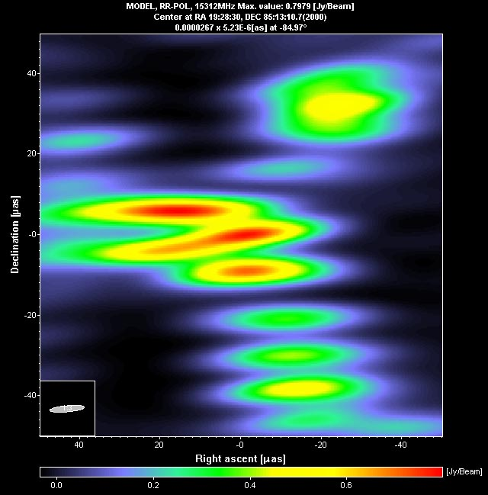
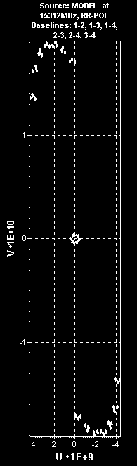
MFS with Radioastron
No MFS
With MFS

Slide 18
MFS with Radioastron
Radioastron capable of observing in MFS at K-band:
Sub-Band No | Sub-Band (MHZ) | SEFD SRT (kJy) | 5dS _{GBT-SRT} (mJy) ^{(*}
F-4 | 18 392 | 26 | 700
F-3 | 19 352 | 28 | 740
F-2 | 20 312 | 31 | 775
F-1 | 21 272 | 34 | 815
F0 | 22 232 | 37 | 850
F1 | 23 192 | 41 | 890
F2 | 24 152 | 46 | 950
F3 | 25 112 | 51 | 1000
*) Δ f = 36 MHz, Tau = 600 sec, SEFD_{GBT} = 15 Jy
One polarization channel (RCP or LCP) operates at a fixed frequency, while the second
polarization channel switches frequency in steps of 960 MHz starting at the lowest value
of 18392 MHz, which corresponds to the 512 MHz IF input of the Formatter.
The highest frequency is 25112 MHz.

Slide 19
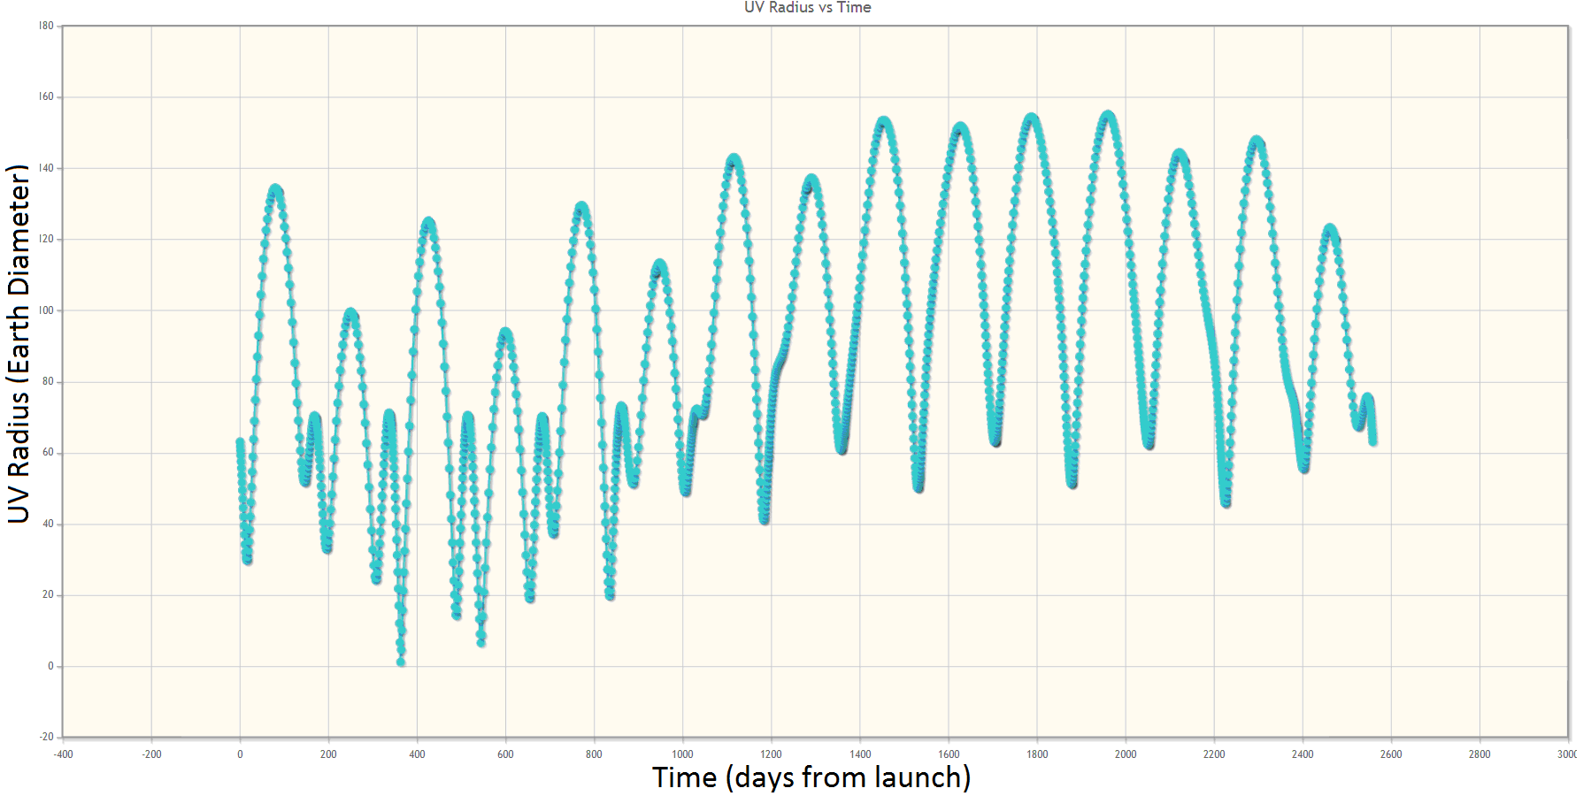
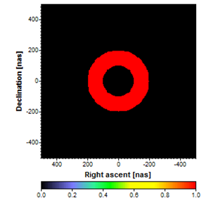
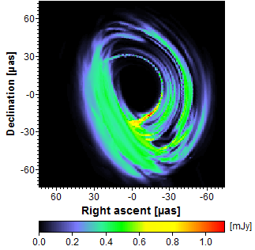
MFS with Millimetron
MFS is very important for Millimetron
to improve the (u,v)-coverage taking into account
orbital, thermal and other possible constraints.
Using ASL Software package were performed simulations for MFS observations of Sgr A* with simple model and several models provided by Jason Dexter (Dexter et. al., 2013).
Simple model
One of the models provided
by Jason Dexter

Slide 20
MFS with Millimetron
Millimetron-Event Horizon Telescope Simulation

Slide 21
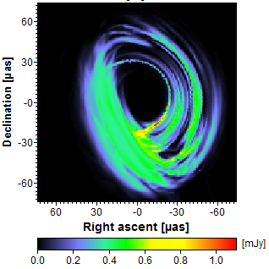
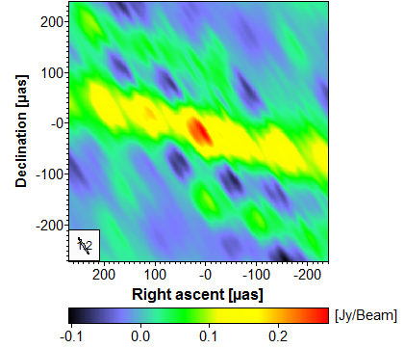
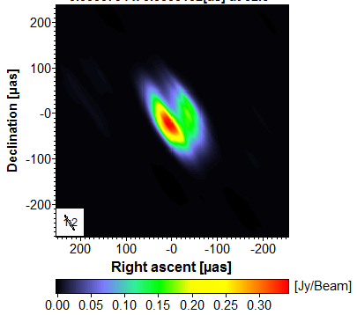



MFS with Millimetron
Millimetron-Event Horizon Telescope Simulation
Model
Dirty map
Clean map
Series of short snapshots merged together (total 8 days), each snapshot can be 5 minutes – 1 hour

Slide 22
Conclusions
New MFI algorithms were developed and implemented in the Astro Space Locator Software. They were tested on the various VLBI data sets, proving the efficiency of MFS.
MFS can essentially improve the UV coverage and increase the dynamic range of the output image.
MFS approach is critical issue that must be used in Space-VLBI missions, like Radioastron and Millimetron, to reduce possible mission constraints.

Slide 23
Thank you for your attention!
Contacts:
Astro Space Center, Lebedev Physical Institute (ASC LPI)
Russian Academy of Sciences
On behalf of Data Processing Department ASC LPI:
S. F. Likhachev
E-mail: slikhach@asc.rssi.ru
V. I. Kostenko
E-mail: vkostenko@asc.rssi.ru
A. G. Rudnitskiy
E-mail: almax1024@gmail.com, arud@asc.rssi.ru
Large Magellanic Cloud as Seen by Herschel and Spitzer
Credit: ESA/NASA/JPL-Caltech/STScI

